Slide 1

SMS – Student Management System

Slide 2

Purpose
To manage database records for multiple entities
To demonstrate database operations via web interface
To interact with database in order to perform different operations
Notes:
Notes to presenter:
What is your purpose for sharing this reflection?
Is it at the end of a unit or project?
Are you sharing this reflection, at the attainment of a learning goal you set for yourself?
Is it at the end of a course?
State your purpose for the reflection or even the purpose of the learning experience or learning goal. Be clear and be specific in stating your purpose.

Slide 3

The architecture of the solution
Apache Web Server
MySQL Database server
Application Server (browser)
MySQL
Web
Apache
Notes:
Notes to presenter:
Description of what you learned in your own words on one side.
Include information about the topic
Details about the topic will also be helpful here.
Tell the story of your learning experience. Just like a story there should always be a beginning, middle and an end.
On the other side, you can add a graphic that provides evidence of what you learned.
Feel free to use more than one slide to reflect upon your process. It also helps to add some video of your process.

Slide 4

What was our process?
Web Interface
Queries to manipulate data
01
04
02
03
Results drawn for given queries
MySQL Server
Notes:
Notes to presenter:
What did you think at first?
What obstacles did you encounter along the way?
How did you overcome those obstacles?
What images can you add to support your process?
This SmartArt allows you add images and text to help outline your process. If a picture is worth a thousand words, then pictures and words should help you communicate this reflection on learning perfectly! You can always click on Insert>SmartArt to change this graphic or select the graphic and click on the Design contextual menu to change the colors.
Feel free to use more than one slide to reflect upon your process. It also helps to add some video of your process.

Slide 5

Importance
Relevance
Significance
Can handle:
Complex queries
Multiple queries
Sub-queries
Indexing
Database constraints
Visually handled database access and manipulation of data
Web-based interface to facilitate insertions, updates, removals and selection of data
Efficient management of:
Exams
Students
Departments
Fees
Exams
Admins
Courses
Notes:
Notes to presenter:
What was important about this learning experience?
How is it relevant to your course, yourself, or your society or community?
Why is this significant?
This SmartArt allows you add images and text to help outline your process. If a picture is worth a thousand words, then pictures and words should help you communicate this reflection on learning perfectly! You can always click on Insert>SmartArt to change this graphic or select the graphic and click on the Design contextual menu to change the colors.

Slide 6
DDL examples
CREATE TABLE `courses` ( `course_id` int(11) NOT NULL, `c_name` varchar(30) NOT NULL, `tutor` varchar(50) NOT NULL, `qualification` varchar(50) NOT NULL, `experience` varchar(30) NOT NULL) ENGINE=InnoDB DEFAULT CHARSET=utf8mb4;
CREATE TABLE `exams` ( `exam_id` int(11) NOT NULL, `student_id` int(11) NOT NULL, `course_id` int(11) NOT NULL, `dept_id` int(11) NOT NULL, `marks` int(11) NOT NULL) ENGINE=InnoDB DEFAULT CHARSET=utf8mb4;
CREATE TABLE `stds` ( `student_id` int(11) NOT NULL, `student_name` varchar(50) NOT NULL, `sex` char(1) NOT NULL, `address` varchar(100) NOT NULL, `contact` varchar(15) NOT NULL) ENGINE=InnoDB DEFAULT CHARSET=utf8mb4;
Notes:
Notes to presenter:
Description of what you learned in your own words on one side.
Include information about the topic
Details about the topic will also be helpful here.
Tell the story of your learning experience. Just like a story there should always be a beginning, middle and an end.
On the other side, you can add a graphic that provides evidence of what you learned.
Feel free to use more than one slide to reflect upon your process. It also helps to add some video of your process.

Slide 7
DML Complex queries
SELECT e.exam_id, s.student_name, c.c_name, d.dept_name , e.marks
FROM exams e
INNER JOIN courses c
ON e.course_id = c.course_id
INNER JOIN depts d
ON e.dept_id=d.dept_id
INNER JOIN stds s
ON e.student_id = s.student_id
WHERE s.student_name LIKE '%$query%'
SELECT stds.student_na me, fees.receipt_no, fees.dated, fees.tution_fee
FROM stds
INNER JOIN fees ON stds.student_id = fees.student_id WHERE stds.student_n ame LIKE ‘ %$query%'
update courses set c_name='$cna me', tutor='$tutor', qualification=‘ $qual', experience='$ exp' where course_id='$id'
Notes:
Notes to presenter:
Description of what you learned in your own words on one side.
Include information about the topic
Details about the topic will also be helpful here.
Tell the story of your learning experience. Just like a story there should always be a beginning, middle and an end.
On the other side, you can add a graphic that provides evidence of what you learned.
Feel free to use more than one slide to reflect upon your process. It also helps to add some video of your process.

Slide 8
Database constraints and indexing
ALTER TABLE `stds` ADD PRIMARY KEY(`student _id`),
ADD UNIQUE KEY`student_ name` (`student_na me`);
ALTER TABLE `enrollments`
ADD CONSTRAINT `FK_course_id1` FOREIGN KEY (`course_id`) REFERENCES `courses` (`course_id`), ADD CONSTRAINT `FK_dept_id` FOREIGN KEY (`dept_id`) REFERENCES `depts` (`dept_id`), ADD CONSTRAINT `FK_std_id3` FOREIGN KEY (`student_id`) REFERENCES `stds` (`student_id`);
Notes:
Notes to presenter:
Description of what you learned in your own words on one side.
Include information about the topic
Details about the topic will also be helpful here.
Tell the story of your learning experience. Just like a story there should always be a beginning, middle and an end.
On the other side, you can add a graphic that provides evidence of what you learned.
Feel free to use more than one slide to reflect upon your process. It also helps to add some video of your process.

Slide 9
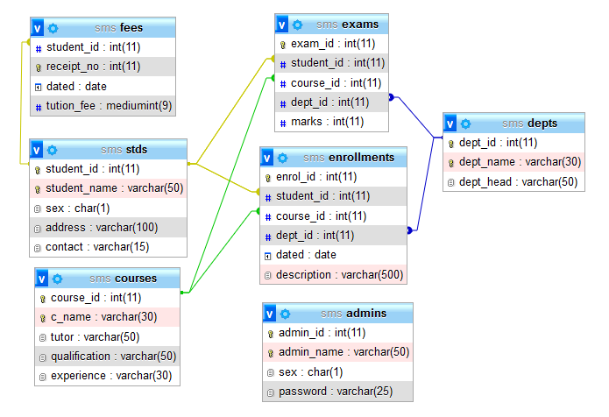
ERD
Notes:
Notes to presenter:
Description of what you learned in your own words on one side.
Include information about the topic
Details about the topic will also be helpful here.
Tell the story of your learning experience. Just like a story there should always be a beginning, middle and an end.
On the other side, you can add a graphic that provides evidence of what you learned.
Feel free to use more than one slide to reflect upon your process. It also helps to add some video of your process.

Slide 10
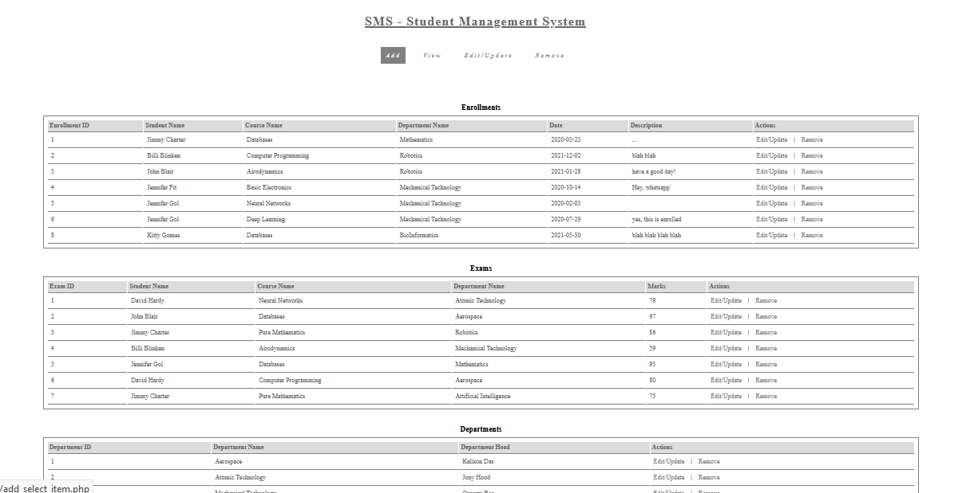
Web Interface
Notes:
Notes to presenter:
Description of what you learned in your own words on one side.
Include information about the topic
Details about the topic will also be helpful here.
Tell the story of your learning experience. Just like a story there should always be a beginning, middle and an end.
On the other side, you can add a graphic that provides evidence of what you learned.
Feel free to use more than one slide to reflect upon your process. It also helps to add some video of your process.

Slide 11
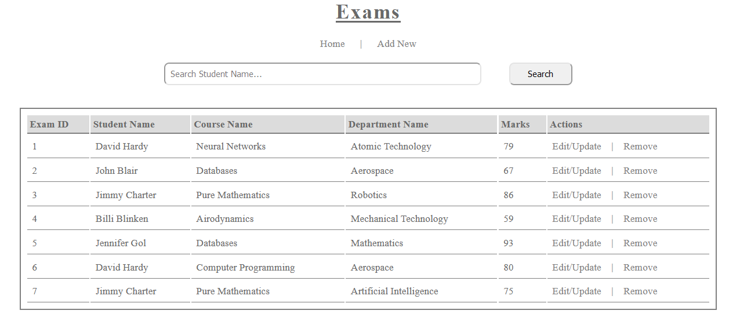
View Data
Notes:
Notes to presenter:
Description of what you learned in your own words on one side.
Include information about the topic
Details about the topic will also be helpful here.
Tell the story of your learning experience. Just like a story there should always be a beginning, middle and an end.
On the other side, you can add a graphic that provides evidence of what you learned.
Feel free to use more than one slide to reflect upon your process. It also helps to add some video of your process.

Slide 12
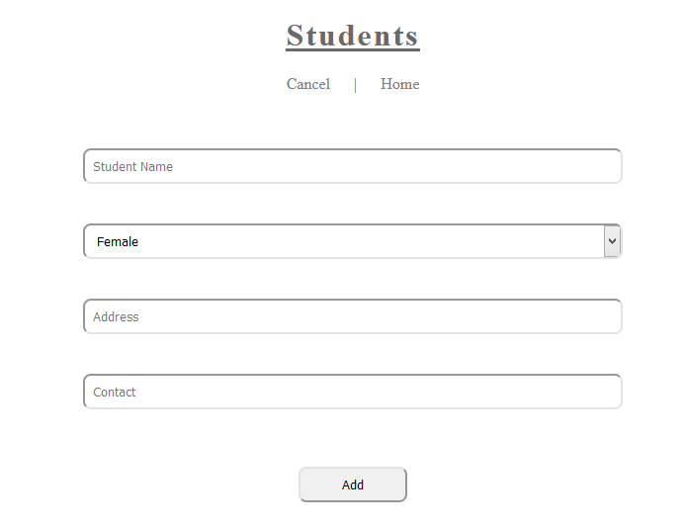
Add New Data
Notes:
Notes to presenter:
Description of what you learned in your own words on one side.
Include information about the topic
Details about the topic will also be helpful here.
Tell the story of your learning experience. Just like a story there should always be a beginning, middle and an end.
On the other side, you can add a graphic that provides evidence of what you learned.
Feel free to use more than one slide to reflect upon your process. It also helps to add some video of your process.

Slide 13
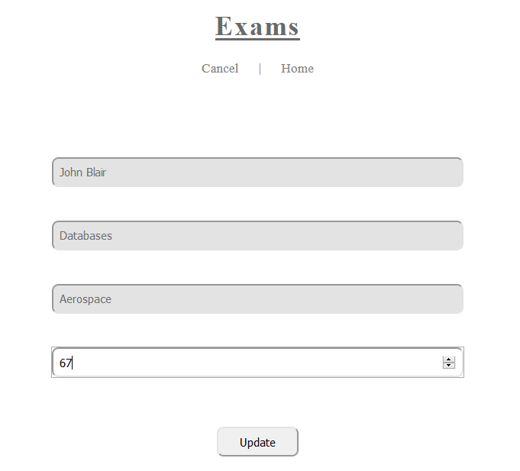
Edit/Update Data
Notes:
Notes to presenter:
Description of what you learned in your own words on one side.
Include information about the topic
Details about the topic will also be helpful here.
Tell the story of your learning experience. Just like a story there should always be a beginning, middle and an end.
On the other side, you can add a graphic that provides evidence of what you learned.
Feel free to use more than one slide to reflect upon your process. It also helps to add some video of your process.

Slide 14
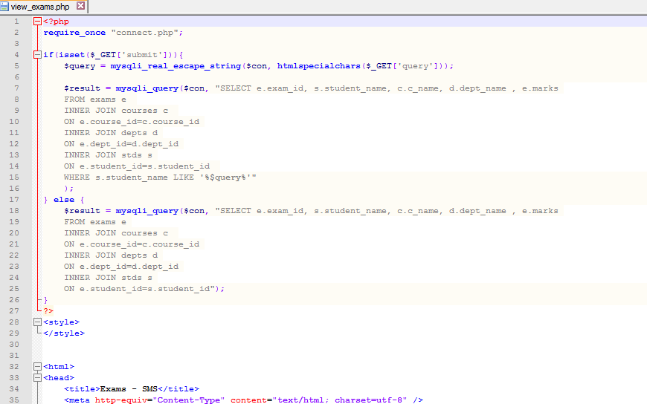
PHP code example
Notes:
Notes to presenter:
Description of what you learned in your own words on one side.
Include information about the topic
Details about the topic will also be helpful here.
Tell the story of your learning experience. Just like a story there should always be a beginning, middle and an end.
On the other side, you can add a graphic that provides evidence of what you learned.
Feel free to use more than one slide to reflect upon your process. It also helps to add some video of your process.

Slide 15

What are your next steps?
More complex queries/joins
4
Incorporating novel web technologies like ajax, react
3
2
Security
1
Maintenance
Notes:
Notes to presenter:
What steps will you be taking as a result of this learning experience?
Did you learn from any failed experiences? How will you do things differently?
What advice will you give to others so they can learn from your experiences?
How can you share what you learned with a real-world audience?
Some examples of next steps might be:
After delivering my first persuasive presentation, I am thinking about joining the debate team.
After making my first film, I’m considering entering it in our school film festival or local film festival.
After connecting with this career expert, I’d like to do some research on that career field because it sounds interesting to me.
This SmartArt allows you add images and text to help outline your process. If a picture is worth a thousand words, then pictures and words should help you communicate this reflection on learning perfectly! You can always click on Insert>SmartArt to change this graphic or select the graphic and click on the Design contextual menu to change the colors.
Feel free to use more than one slide to share your next steps. It also helps to add some video content to explain your message.

Slide 16
The End!
Thanks

